Slide 1
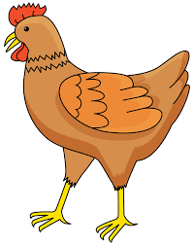
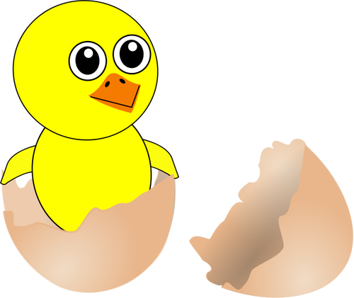
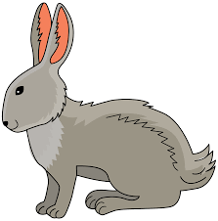
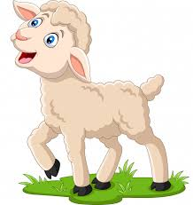
To kura Pelagia.
Ko, ko, ko, ko, ko, ko..
To pisklak Cyryl. Pi, pi, pi, pi, pi, pi….
To zając Walenty. Kic, kic, kic, kic, kic…
To baranek Gutek.
Be, be, be, be…..
WIELKANOCNE SYMBOLE

