Slide 1
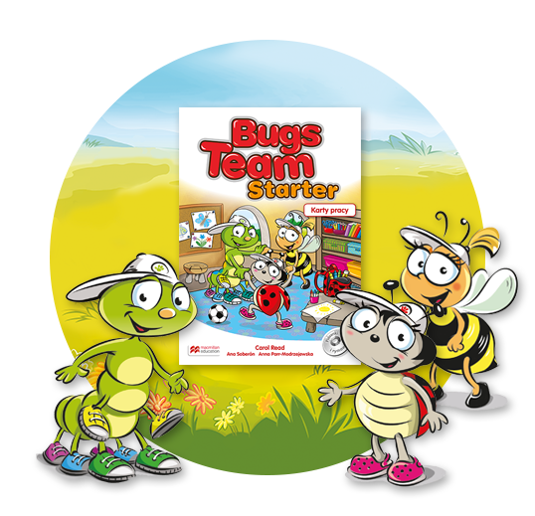
Storytelling
Unit 6
I want to be an artist!

Slide 2
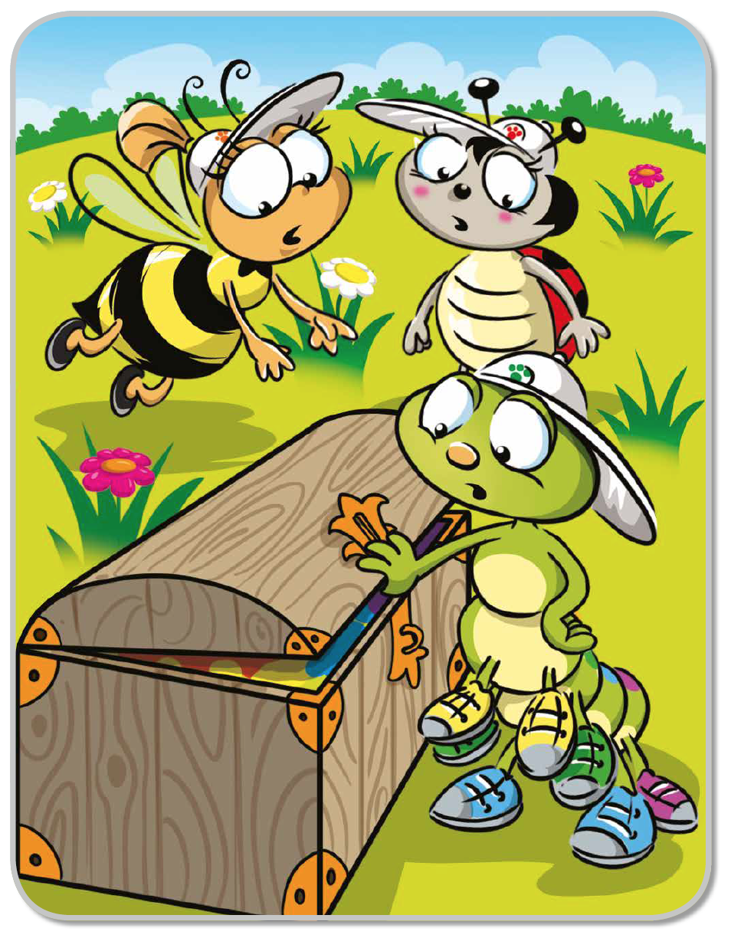
What’s this?

Slide 3
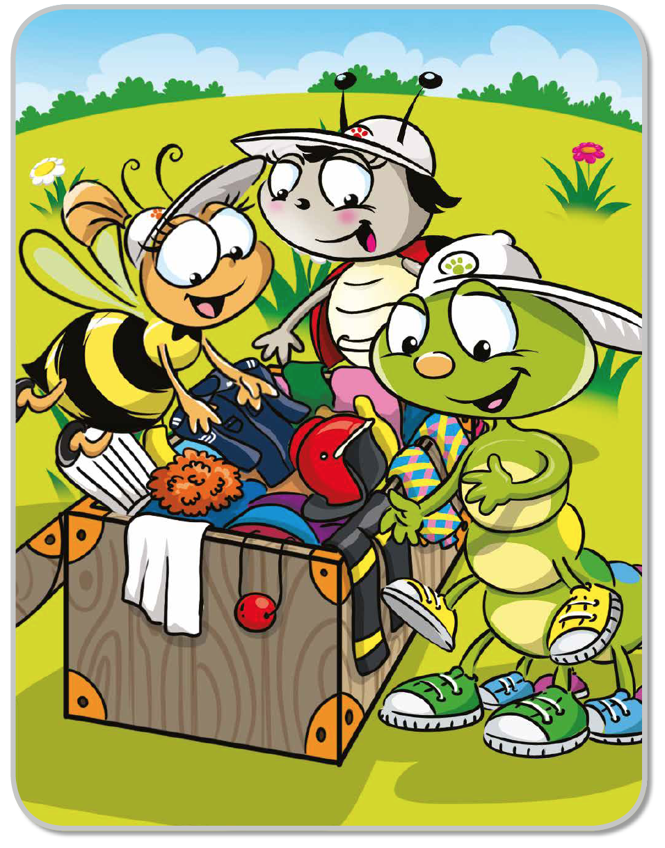
What is inside?
What game do Bugs play?

Slide 4
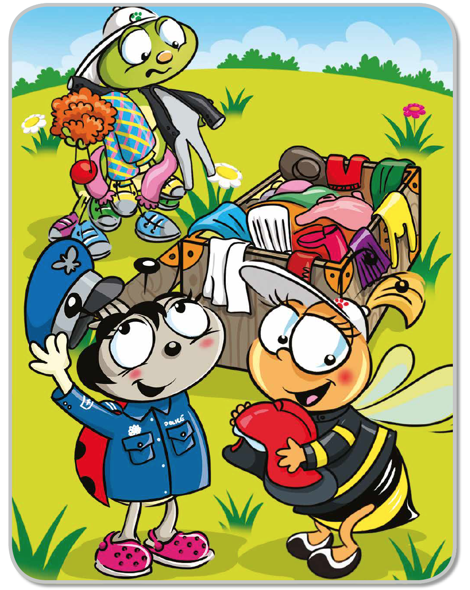
What does Lucy want to be?
What does Bella want to be?

Slide 5
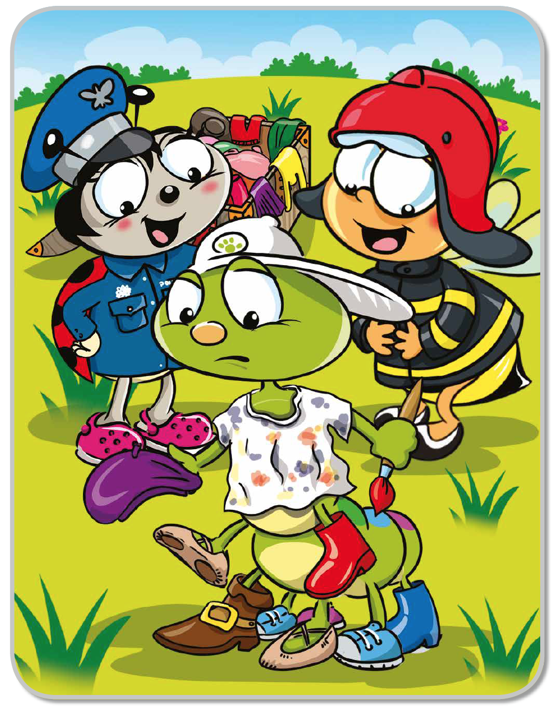
What does Colin want to be?

Slide 6
The end!

